Slide 1
Efficient Architectures Model Scaling

Slide 2
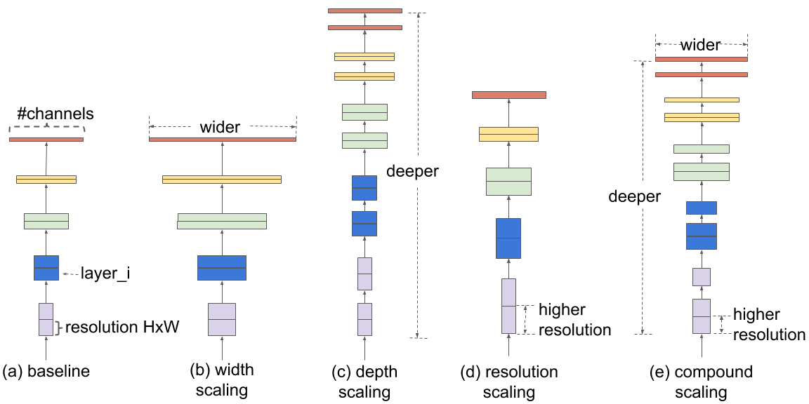
CNN Model Scaling

Slide 3
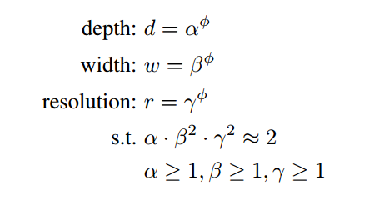
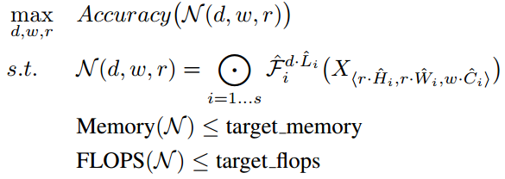
Compound Model Scaling
For 2ᶲ times more computational resources :

Slide 4
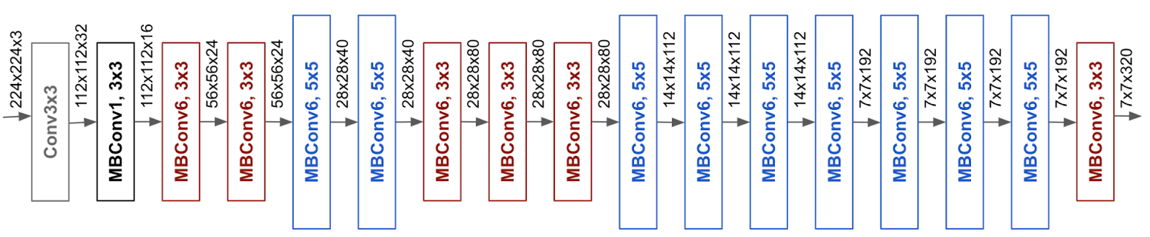
EfficientNet
Performed NAS to come up with a baseline network using the AutoML MNAS framework.
The resulting architecture uses mobile inverted bottleneck (MBConv).
Alpha=1.2, beta=1.1, gamma=1.15

Slide 5
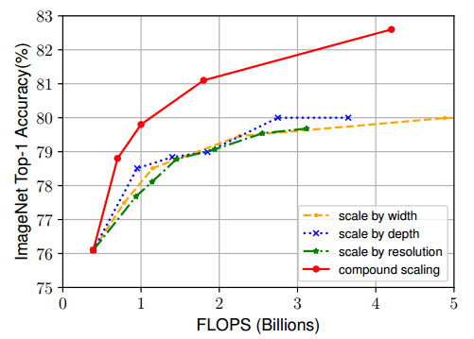
Scaling EfficientNet

Slide 6
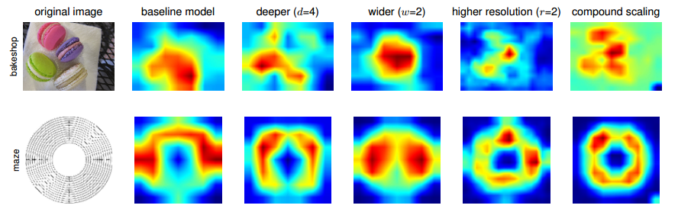
Scaling EfficientNet

Slide 7
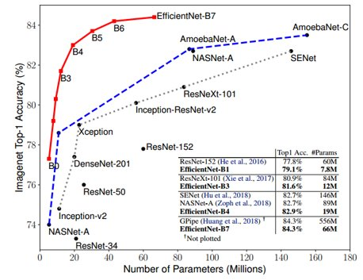
EfficientNet on Imagenet
8.6x smaller in size and 6.1x faster on inference with SOTA accuracy of 84.3% (same as GPipe)
7.6x smaller and 5.7x faster than ResNet-152

Slide 8
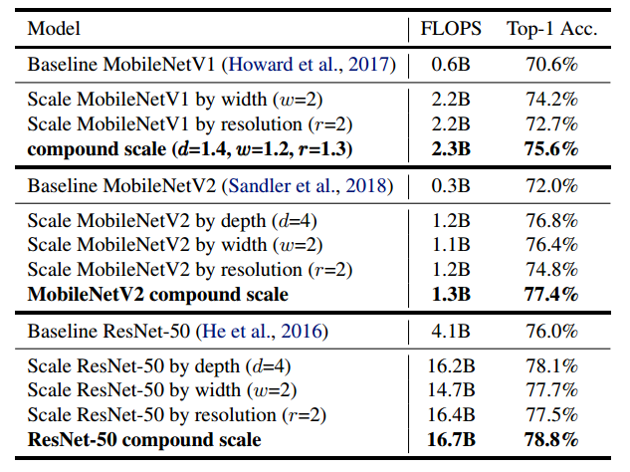
Scaling MobileNets & ResNet

Slide 9
2 Stage Detectors
e.g. Faster RCNN and Mask RCNN
1 Stage Detectors
e.g. YOLO, SSD, EfficientDet
Regions of interest are predicted by an RPN
Further process these regions.
Objects and their classes are predicted in a single stage.
Slower but more accurate.
Faster but less accurate.

Slide 10
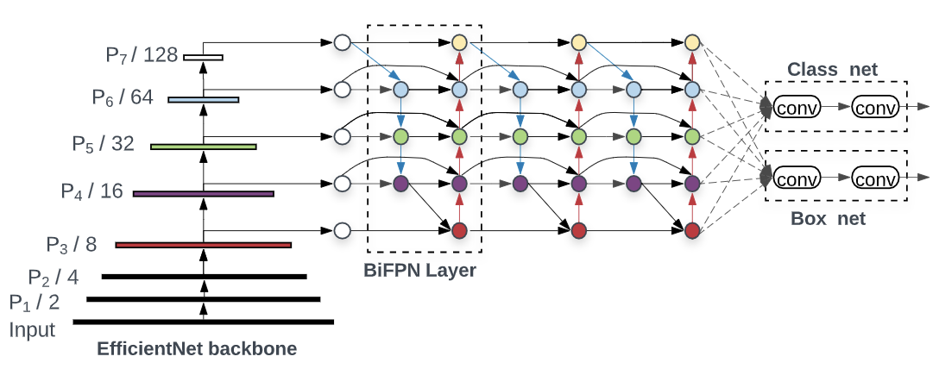
Architecture

Slide 11
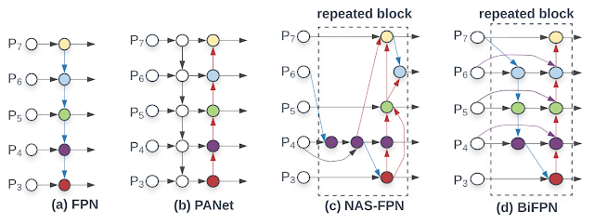
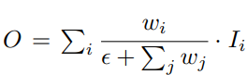
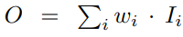
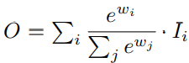
BiFPN Layer
Cross scale connections.
Weighted feature fusion.
Unbounded fusion:
Softmax-based fusion:
Fast normalized fusion:

Slide 12
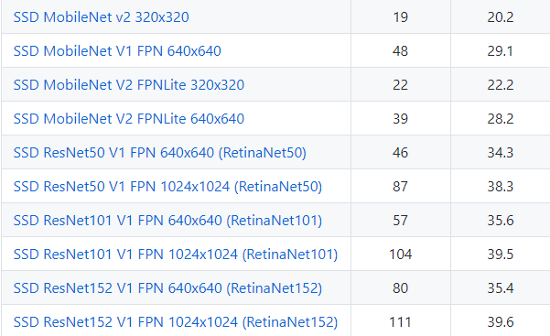
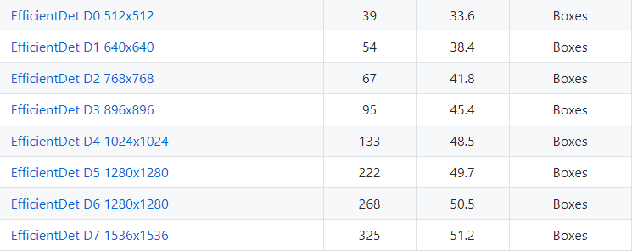
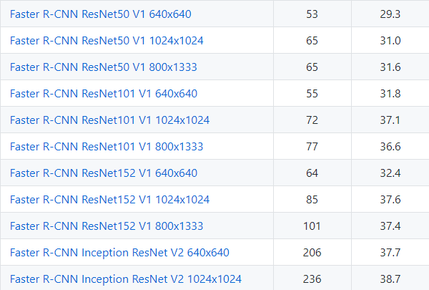
OD Performance
*
*
*

Slide 13
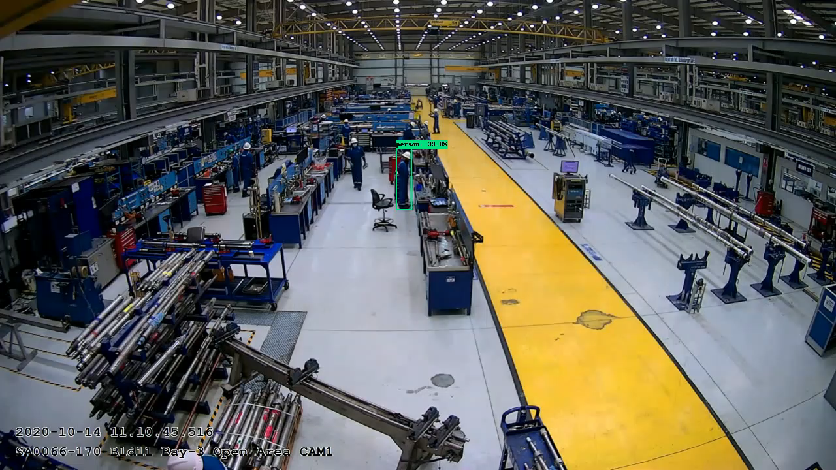

Inference Comparison
SSD MobileNet V2 FPNLite 640x640
EfficientDet D2 768x768
Total inference time - 1548.40 seconds
0.048 second per frame (~21 FPS)
2.6 times faster
Total inference time - 3975.87 seconds
0.124 second per frame (~8 FPS)

Slide 14
